Slide 1
Quantum Support Vector Machine
Ronak Nahata, Param Shah, Megh Shah, Ronak Jain

Slide 2
Outline
Classical SVM
Classical SVM with quantum kernel
QSVM

Slide 3



Classification Problems

Slide 4
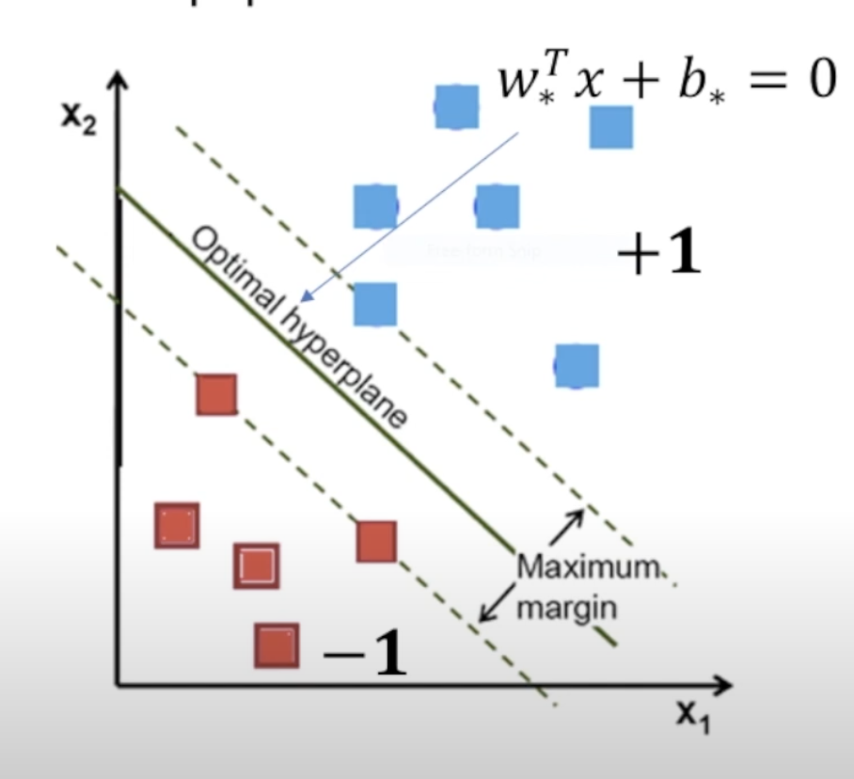
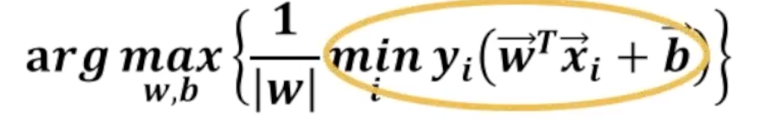
Support Vector Machines

Slide 5
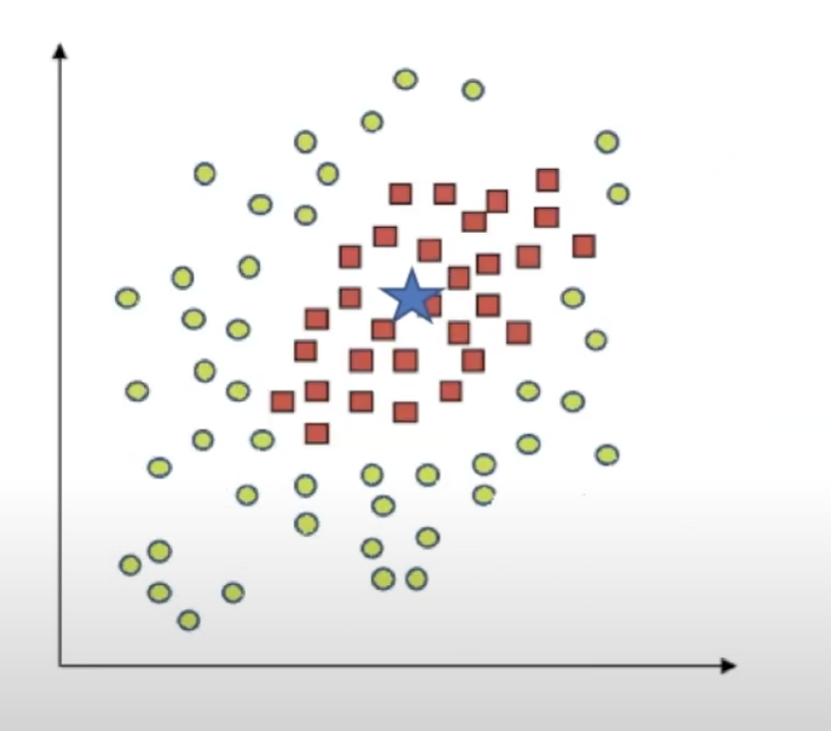
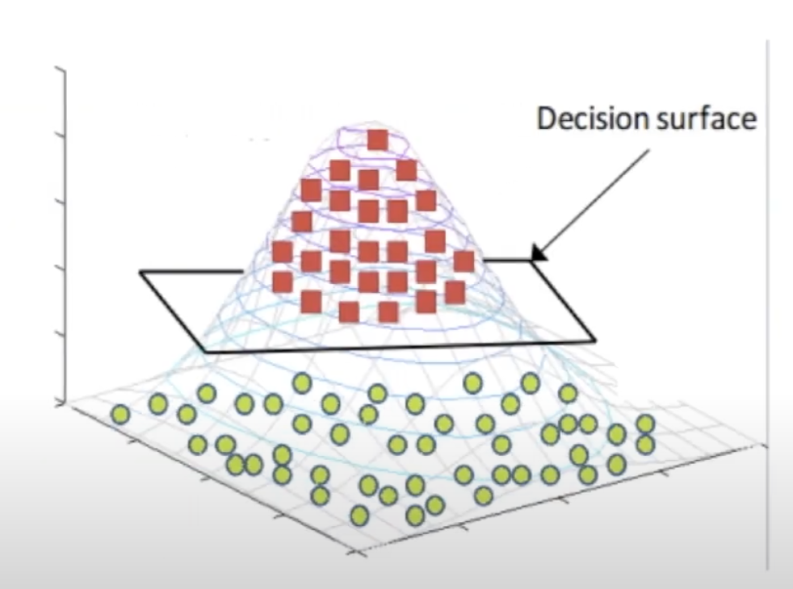
SVM-Non linear hyperplane

Slide 6
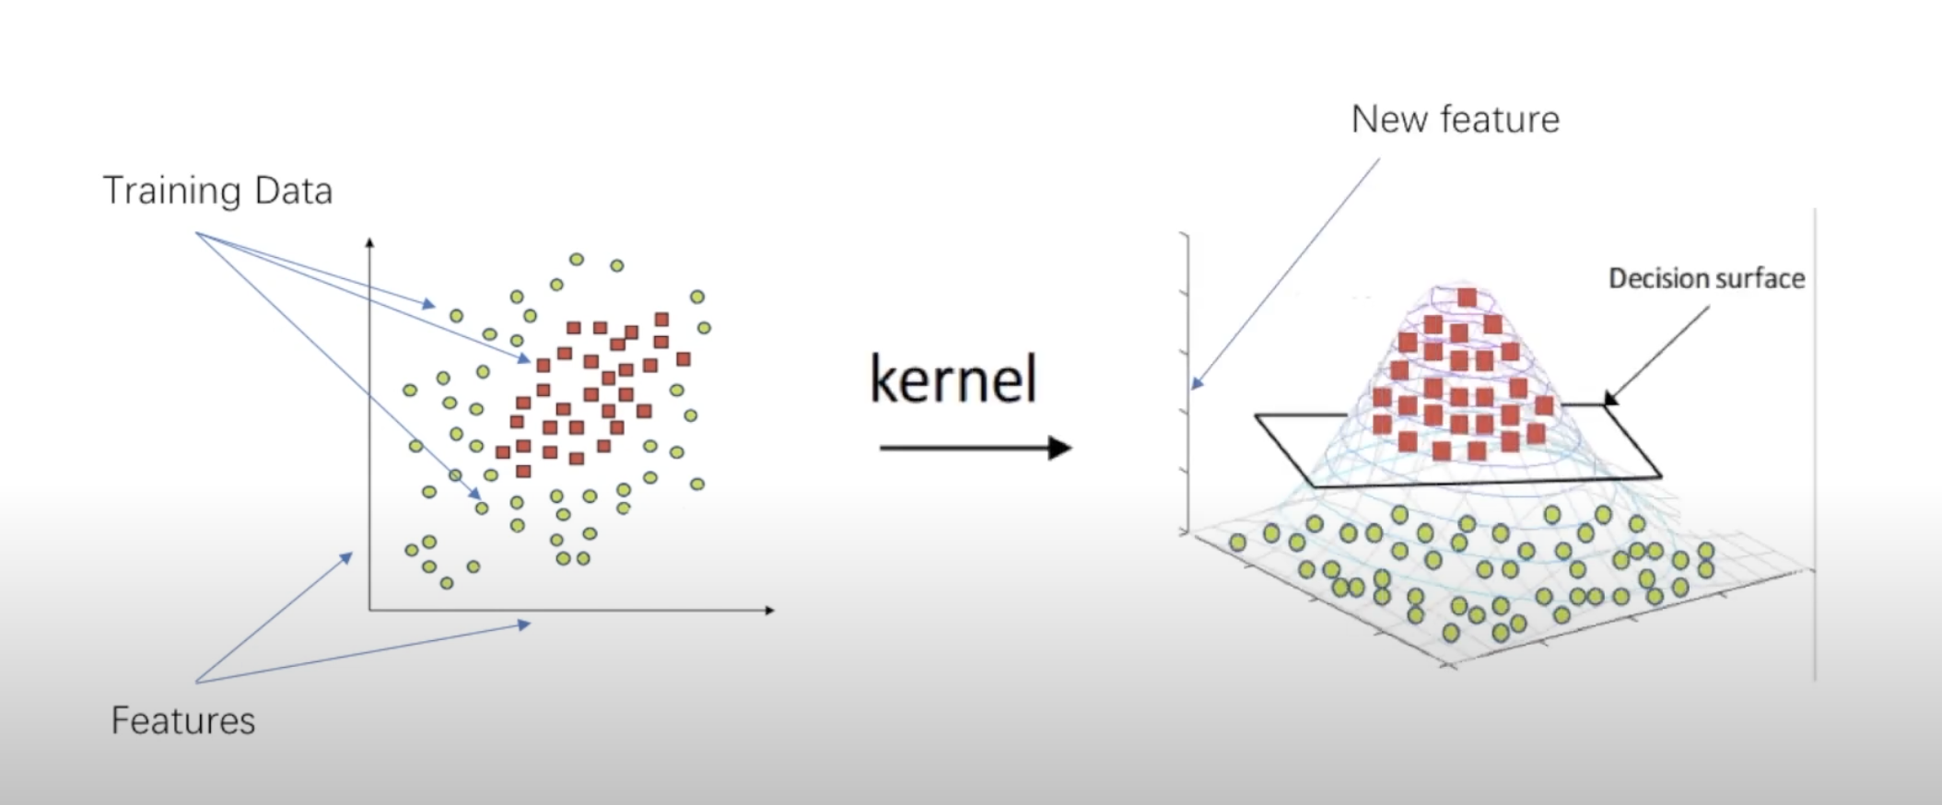
Kernel Methods

Slide 7
SVM steps
Training Set Generation
Feature Mapping
Kernel Calculation
Optimise Weights
Use Test Set to verify Classifier

Slide 8

What if…
We hacked the kernel such that K(x_{i} , x_{j} ) is efficient to calculate on QC but super difficult on classical computer.
→ Quantum Support Vector Machine (QSVM)

Slide 9
QSVM with kernel approximation
Training Set Generation specifically for Quantum Computer
Quantum Feature Mapping
Quantum Kernel Calculation
Optimise Weights
Use Test Set to verify Classifier

Slide 10
Quantum SVM-Variational Circuit {Variational eigenSolver}
Training Set Generation specifically for Quantum Computer
Quantum Feature Mapping
Optimisation done with QC (not calculating kernel)
Use Test Set to verify Classifier

